Slide 1
A STUDY OF WORKERS SATISFACTION & PERFORMANCE IN OSAKAI ENGINEERING INDUSTRIES PVT LTD.
TITLE OF THE PROJECT:

Slide 2
INTRODUCTION :
An Employee/worker satisfaction is a factor in motivation,retention and goal achievement in the place of work and commitment is a factor that include no excess work load,treating employee with respect,provide recognition & rewards,fringe benefits and positive management.Employee performance is the value of a series of employee behaviour that contribute positively to the achievement of organizational goals.

Slide 3
INTRODUCTION (continuation):
The employee satisfaction effects commitments of management and staff. Factors affecting employee satisfaction and commitment are rewards,leave,benefits and compensation given to the staff by the management which are important to improve the motivation level and employee satisfaction & employees are required with their positive atmosphere of the working environment and as long as they identity the responsibility with positive leader behaviour,and lead with the excellent organization communication,which in turn influences the overall performance of the organization.

Slide 4
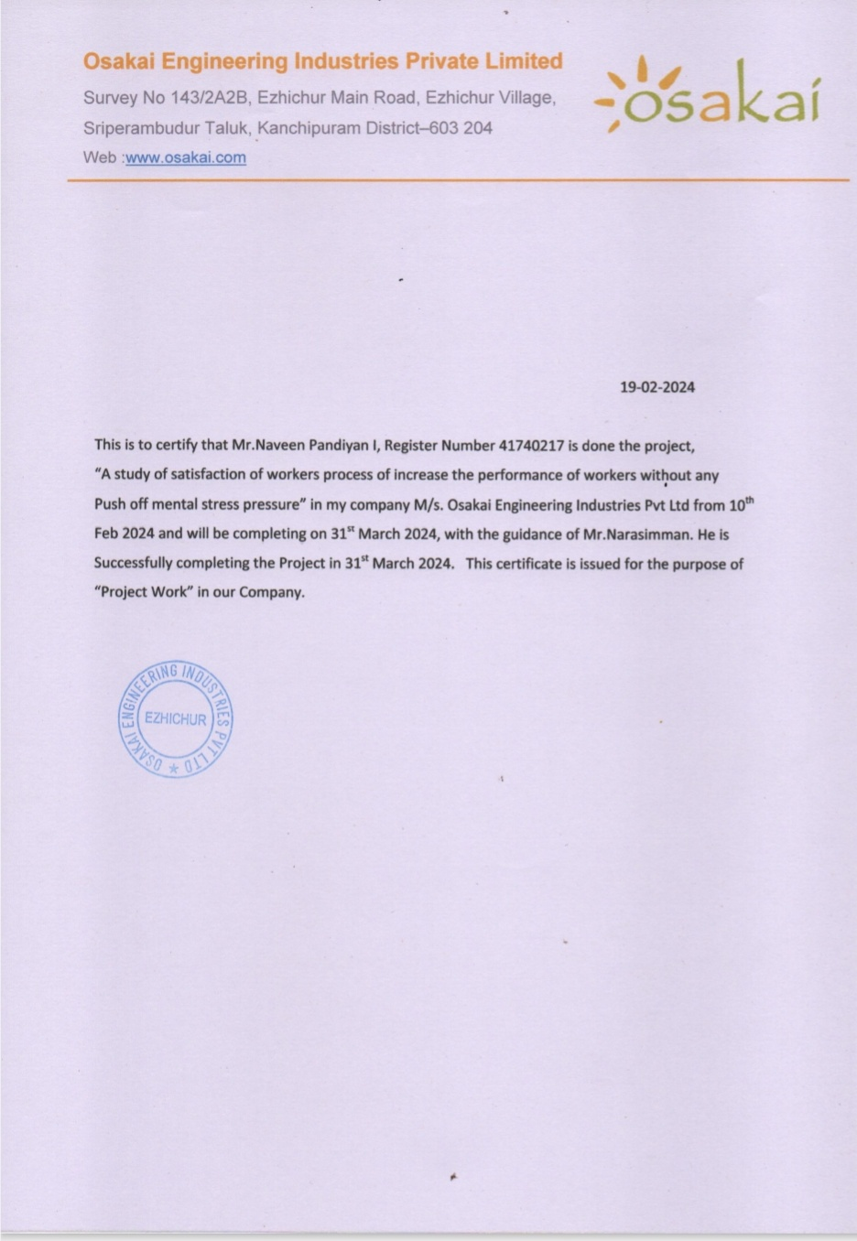
COMPANY LETTER

Slide 5
OBJECTIVES OF THE STUDY:
To identify the Satisfaction of the Employee/worker
To find the strategies for increasing the Employee satisfaction
How to identify the performance of workers in organization?
How to increase the satisfaction of the workers?
What are the ways to increase the performance without any mental stress?

Slide 6
LITERATURE REVIEW:
Eli Ayawo Atatsi,Jol Stoffers,Ad Kil(2019) A study of Factors affecting employee performance: A systematic literature review.
Journal of Advances in Management Studies Research
16(3),329-351,2019
The purpose of this research paper is to synthesize the fragemented literature on organizational citizenship behaviour,Leader-member exchange,Learning,Innovative work Behaviour and employee performance.They shows positive relationships between the behaviours and employee performance.This paper has important managerial implications for practitioners. The analysis can support the understanding of employee performance from a broader and more diverse points and help in providing insight into real-life opportunities,Constraints and solutions in enhancing performance management

Slide 7
2 LIT.,REVIEW:
Hagos Brhane,Shimels Zewdie (2018), A literature review on the effects of employee relation on improving employee performance
International Journals of Multi-Dimensional Research 6(4),66-76,2018
This conceptual paper tries to examine the basic concepts employee relation and its effects on employee performance through investigating a number of employee relationship management components such as communication,participative leadership,shared goals and value,mutual trust,motivation and conflict management. The study also discusses on employee performance which comprises of the basic concept and measurements of performance.Finally,it was suggested that future researchers should investigate profoundly to come up with notable empirical results.

Slide 8
3 LIT., REVIEW:
Employee Attitudes and Employee Performance., Arthur H Brayfield, Walter H Crockett (1955)
Psychological Bulletin 52(5),396,1955., American Psychological Association.
An examination is made on the empirical literature bearing upon the relationships between employee attitudes and employee performance. A discussion of methodological questions includes considerations of sampling,of criterion measures, and of general problems of analysis and design.Theoritical considerations include the employee’s outside environment, and both union and company structures.

Slide 9
4 LIT., REVIEW
Brikend Aziri (2011), Job Satisfaction: A Literature Review.
Management research & practice 3(4),2011
Job satisfaction represents one of the most complex areas facing today’s managers when it comes to managing their employees.Many studies have demonstrated an unusually large impact on the job satisfaction on the motivation of workers,while the level of motivation has an impact on productivity, and hence also on performance of business organizations. Unfortunately,in our region,job satisfaction has not still recevied the proper attention from neither scholars nor managers of business organizations.

Slide 10
5 LIT., REVIEW :
Theo Van der Voordt, Per Anker Jensen(2023)., The impact of healthy workplaces on employee satisfaction,Productivity and Costs.
Journal of corporate Real Estate 25(1),29-49,2023 in Emerald Publishing.
This paper aims to explore the added value of healthy workplaces for employees and organizations,in particular regarding employee satisfaction,labour productivityand facility cost.The paper is based on a narrative review of journal papers and other sources covering the fields of building research,Corporate real estate management,facilities management,environmental psychology and ergonomics.The review supports the assumption of positive impacts of appropriate building characteristics on health,Satisfaction and productivity.It indicate that investing in healthy work environment is cost-effective.

Slide 11
6 LIT., REVIEW:
Samreen Naz,Hariom Sharma(2017)., Job Satisfaction among different working organizations: A literature review.
Research Journal of Social Science and Management 7(6),29-37,2017.
Job satisfaction denotes to the workers’ perception of their workplace settings,relationships amid fellows,salary as well as endorsement opportunities.In healthcare services environment with tension and division of labour,the basic challenge is to perform well in these kinds of settings.Teachers,Bank employees,Corporate managers,Salespeople and all the occupation workers are not highly pleased with their occupation.Other researchers showed that job satisfaction is significant for each and every level of employee in every organization and in both private and Government sector.

Slide 12
RESEARCH METHODOLOGY
RESEARCH DESIGN:
The research design followed in this study is descriptive research design.
The problem of the study is to find out the satisfaction of employee & strategies for increasing the performance of the employees without any mental pressure.
B. SAMPLING TECHNIQUE:
Sampling type is random sampling method is used.
C. SOURCE OF DATA:
The Two sources data were collected are primary & secondary Data.

Slide 13
continuation:
Primary Data:
Primary are collected through questionnaire.
Second Data:
Secondary data are collected from internet.
D. SAMPLING SIZE:
A sampling of 120 respondent were consideration for the study and data was collected.

Slide 14
CONTINUATION:
E. PERIOD OF THE STUDY:
This study was done for a period of 2 months.
ANALYTICAL TOOLS:
This study uses the following statistical tool for analyzing the collected data.
1. Percentage
2. Chi-square

Slide 15
ANALYSIS:
The percentage canbe calculated as No.of respondents divided by the No.of employees and it can be multiplying by the 100.
PERCENTAGE = No.of Respondents x 100
No.of Employees

Slide 16
PREPARATION OF QUESTIONNAIRE:
A. NAME OF THE EMPLOYEE: ___________________________
B. AGE OF THE EMPLOYEE
BELOW 25
25 YR- 35 YR
36 YR- 45 YR
ABOVE 46
C. GENDER OF THE EMPLOYEE
I) MALE II) FEMALE III) OTHER

Slide 17
D. MARTIAL STATUS OF THE EMPLOYEE
MARRIED
UNMARRIED
SEPARATED
E. DEPARTMENT OF THE EMPLOYEE
FINANCE & ACCOUNTING
SALES & MARKETING
HUMAN RESOURCES
MANUFACTURING
F. EDUCATIONAL QUALIFICATION
I) 12TH STD II) DIPLOMA COURSES III) DEGREE COURSE

Slide 18
G. HAVE YOU SATISFIED IN YOUR JOB?
YES
NO
OTHER
H. IF IT IS NO, WHAT IS THE REASON?
INSECURE FEELING
ROUGH RELATIONSHIP WITH CO-WORKERS
UNHEALTHY WORKING ENVIRONMENT
SALARY ISSUES
ALL OF THE ABOVE

Slide 19
I. HOW LONG YOU HAVE BEEN WORKING IN THE INDUSTRY?
LESS THAN 3 YEARS
3-5 YEARS
MORE THAN 5 YEARS
J. HOW DO YOU FEEL THE WORKING ENVIRONMENT?
EXCELLENT
GOOD
SATISFACTORY
NOT SATISFACTORY
NONE OF THE ABOVE

Slide 20
K.HOW SECURE DO YOU FEEL IN YOUR JOB
HIGH SECURE
SECURE
INSECURE
L. HOW DO YOU FEEL THE SMOOTH RELATIONSHIP WITH YOUR EMPLOYERS & CO-WORKERS?
VERY HIGH
HIGH
MEDIUM
LOW
VERY LOW

Slide 21
QUESTIONNAIRE FOR WORKERS PERFORMANCE:
1. How hard working is your worker?
Extremely Hardworking
Very Hardworking
Hardworking
Slightly Hardworking
Not at all Hardworking
2.How effective at his/her job is your worker?
Very Effective
Moderately Effective
Not Very Efffective
Not at all Effective

Slide 22
3. How often does your employee meet his/her deadlines?
Always
Most of the time
About half the time
Once in a while
Never
4. How well does your employee work with other employees?
Extremely Well
Very Well
Minimum in the team
Not Well
Badly

Slide 23
5. How well does your employee share responsibility with other workers for tasks?
Extemely Well
Very Well
Slightly Well
Not at all Well
6. How quickly does your employee follow up on requests?
Extremely quickly
Very quickly
Within acceptable limits
Not at all quickly
Slowly

Slide 24
7. How well does your employee handle criticism of his/her work?
Extremely Well
Very Well
Well Enough
Not Well
Not at all Well
8. How knowledgable is your employee about the company’s goals?
Extremely knowledgeable
Very knowledgeable
Moderately knowledgeable
Slightly knowledgeable
Not at all Knowledgeable

Slide 25
9. In your words, what is the reason for decreasing the performance of employees in your company?
Type One or Few Words (Max., 500 words)

Slide 26
10. In your own words,what would your employee need to do to improve his/her performance?
Type one or Few words (max. 500 words)

Slide 27
ANALYSIS:
1. Have You Satisfied In Your Job?
OPINION | NO.OF RESPONDENTS | PERCENTAGE
YES | 3O WORKERS | 25%
NO | 85 WORKERS | 70.83%
OTHER | 5 WORKERS | 4.16%

Slide 28
2. IF IT IS NO, WHAT IS THE REASON?
TOPIC | NO.OF RESPONDENTS | PERCENTAGE
INSECURE FEELING | 30 | 25%
ROUGH RELATIONSHIP WITH CO-WORKERS | 22 | 18.33%
UNHEALTHY WORKING ENVIRONMENT | 52 | 43.33%
SALARY ISSUES | 12 | 10%
ALL OF THE ABOVE | 4 | 3.34%

Slide 29
3. HOW LONG YOU HAVE BEEN WORK IN THE INDUSTRY?
TOPIC | NO.OF RESPONDENTS | PERCENTAGE
LESS THAN 3 YEARS | 25 | 20.83%
3-5 YEARS | 35 | 29.17%
MORE THAN 5 YEARS | 60 | 50%

Slide 30
4. HOW DO YOU FEEL THE WORKING ENVIRONMENT?
TOPIC | NO.OF RESPONDENTS | PERCENTAGE
EXCELLENT | 30 | 25%
GOOD | 70 | 58.3%
SATISFACTORY | 15 | 12.5%
NOT SATISFACTORY | 5 | 4.2%
NONE OF THE ABOVE | NIL | NIL

Slide 31
5. HOW SECURE DO YOU FEEL IN YOUR JOB
TOPIC | NO.OF RESPONDENTS | PERCENTAGE
HIGH SECURE | 46 | 38.34%
SECURE | 37 | 30.83%
INSECURE | 37 | 30.83%

Slide 32
6. HOW DO YOU FEEL THE SMOOTH RELATIONSHIP WITH YOUR EMPLOYERS & CO-WORKERS?
TOPIC | NO.OF RESPONDENTS | PERCENTAGE
VERY HIGH | 40 | 33.34%
HIGH | 20 | 16.67%
MEDIUM | 30 | 25%
LOW | 20 | 16.67%
VERY LOW | 10 | 8.33%

Slide 33
7. How hard working is your worker?
TOPIC | NO.OF RESPONDENTS | PERCENTAGE
Extremely Hardworking | 55 | 45.84%
Very Hardworking | 40 | 33.34%
Hardworking | 10 | 8.34%
Slightly Hardworking | 10 | 8.34%
Not at all Hardworking | 5 | 4.16%

Slide 34
8. How effective at his/her job is your worker?
TOPIC | NO.OF RESPONDENTS | PERCENTAGE
Very Effective | 35 | 29.17%
Moderately Effective | 25 | 20.83%
Not Very Efffective | 45 | 37.5%
Not at all Effective | 25 | 20.83%

Slide 35
9. How often does your employee meet his/her deadlines?
TOPIC | NO.OF RESPONDENTS | PERCENTAGE
Always | 5 | 4.17%
Most of the time | 10 | 8.33%
About half the time | 30 | 25%
Once in a while | 30 | 25%
Never | 45 | 37.5%

Slide 36
10. How well does your employee work with other employees?
TOPIC | NO.OF RESPONDENTS | PERCENTAGE
Extremely Well | 55 | 45.84%
Very Well | 30 | 25%
Minimum in the team | 20 | 16.68%
Not Well | 10 | 8.34%
Badly | 5 | 4.17%

Slide 37
11. How well does your employee share responsibility with other workers for tasks?
TOPIC | NO.OF RESPONDENTS | PERCENTAGE
Extemely Well | 20 | 16.67%
Very Well | 30 | 25%
Slightly Well | 60 | 50%
Not at all Well | 10 | 8.33%

Slide 38
12. How quickly does your employee follow up on requests?
TOPIC | NO.OF RESPONDENTS | PERCENTAGE
Extremely quickly | 20 | 16.67%
Very quickly | 40 | 33.33%
Within acceptable limits | 35 | 29.17%
Not at all quickly | 13 | 10.83%
Slowly | 12 | 10%

Slide 39
13. How well does your employee handle criticism of his/her work?
TOPIC | NO.OF RESPONDENTS | PERCENTAGE
Extremely Well | 22 | 18.33%
Very Well | 38 | 31.67%
Well Enough | 15 | 12.5%
Not Well | 45 | 37.5%
Not at all Well | NIL | NIL

Slide 40
14. How knowledgable is your employee about the company’s goals?
TOPIC | NO.OF RESPONDENTS | PERCENTAGE
Extremely knowledgeable | 20 | 16.67%
Very knowledgeable | 40 | 33.33%
Moderately knowledgeable | 30 | 25%
Slightly knowledgeable | 30 | 25%
Not at all Knowledgeable | NIL | NIL

Slide 41
15. How many workers in the company? (Gender-Wise)
TOPIC | NO.OF RESPONDENTS | PERCENTAGE
MALE | 78 WORKERS | 65%
FEMALE | 32 WORKERS | 26.67%
OTHERS | 10 WORKERS | 8.33%

Slide 42
16. Age of the Employees:
TOPIC | NO.OF RESPONDENTS | PERCENTAGE
BELOW 25 | 26 Workers | 21.67%
25 YR- 35 YR | 34 Workers | 28.33%
36 YR- 45 YR | 43 Workers | 35.83%
ABOVE 46 | 17 Workers | 14.17%

Slide 43
17. No. of workers in Department-Wise
TOPIC | NO.OF RESPONDENTS | PERCENTAGE
Finance & Accounting | 30 Workers | 25%
Sales & Marketing | 30 Workers | 25%
Human Resource | 30 Workers | 25%
Production | 30 Workers | 25%

Slide 44
18. Qualification of the Workers
TOPIC | NO.OF RESPONDENTS | PERCENTAGE
12th STD | 45 Workers | 37.5%
Diploma courses | 10 workers | 8.33%
Degree Courses | 65 Workers | 54.17%

Slide 45
FINDINGS:
The Majority (65%) of the respondents are Male.
The Majority (54.17%) of the respondents are Degree Holders.
The Majority (35.83%) of the respondents are age between 36 - 45 yrs.
The Majority (70.83%) of the respondents are workers who are not satisfied in his/her job.
The Majority (43.33%) of the repondents are not satisfied by the unhealthy working environment.
The Majority (50%) of the respondents are employees who have been work in the industry more than 5 years.
The Majority (58.3%) of the respondents are employees who considered as working atmosphere in good manner.

Slide 46
The Majority (38.34%) of the repondents are the employees who feel the job as a securely.
The Majority (33.34%) of the respondents are the employees who have a smooth relationship with the co-workers.
The Majority (45.84%) of the repondents are the employees who working performance is considered as extremely high level.
The Majority (37.5%) of the respondents are the employees who are not very effective at his/her job.
The Majority (50%) of the repondents are the employees who are sharing the responsibilities with the co-workers for the job/tasks.
The Majority (33.33%) of the respondents are the employees who are very quickly response follow up on request.

Slide 47
SUGGESTIONS:
The main reason for the non satisfaction of the employees is Unhealthy working environment in the company.
So, first we have to change or improve the condition of the working environment for employees. This is very helpful to create or realise the working satisfaction to the employees.
Second, We have to create a good atmosphere for employees with the co-workers to done the job done.
It will help to increase the performance of the employees and also to finish the products within the limited time.
Third, We have to give some job opportunities to the freshers to improve his/her working skills and to know about his performance.

Slide 48
CONCLUSIONS:
In this report, Employee satisfaction is important role played in the performance and growth of a company. It is very important thing to the company because, it is helpful to know about the performance and his/her working skills of the workers, and how to improve the performance of the workers,how to findings the solutions for problems arise from the workers,how to create smooth relationship with the co-workers,how to create a good atmosphere working condition for the employees of a company and measure the hardworking level of the employees to done the job at correct time.We mentioned some suggestions to improve job satisfaction and performance of workers,it is very helpful to attain the highest goal in the company.

Slide 49
...
THANK YOU

